Slide 1
Jala Compiler Project

Slide 2
Temas a tratarse
All Tecnologies and tools, ztree, ace.editor.js Django pgadmin, postman: Andres
Hablar de Building tools Pipenv: Sebastián
Database Modelo entidad relacion: Gonzalo
Diagrama de clases: Alvaro, Andres
Git flow: Sebastian
Un poco de convencion de codigo PEP 8 """ """:
Imagen de la estructura de paquetes: Gonzalo
Hablar de Solid y patrones utilizados: SOL (Gonzalo) Singleton(alvaro), Factory (andres), Façade (inicio) (sebastian)
Manejo de excepciones y unit test: Alvaro
TDD utilizamos? Porque no lo utilizamos?: Alvaro
Listar Bugs conocidos, y propocisiones a implementarse que no se hicieron :

Slide 3
Introduction
Jala Compiler is a web-based code editor that currently supports:
python 2.7
python 3.9
Java 13
JavaScript with node 14.15.1
Php

Slide 4
Objectives
Create a web-app (Rest API) to compile run java, python, JavaScript code, etc.
Be able to:
Register and login as a user
Create new projects
Add files and folders
Run the main file and see the results in the "console"

Slide 5
Technologies and tools
Code Core:
Python
Django (backend framework)
Pipenv (building tool)
Database:
Postgres, PgAdmin,
MySQL, Xampp (at the beginning)
UI Design:
HTML CSS JS,
Ace.js (editor)
Ztree.js (directories structure)
Other Tools:
Git, Github, Sourcetree, GitKraken (Version control)
Pycharm, VsCode
Postman

Slide 6

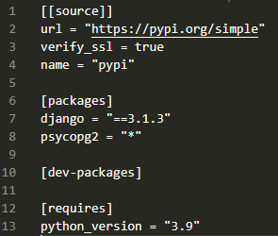
Building tools
All the envorinment was set up an packages were managed with Pipenv.
Pipenv created a virtual environment for us and let us install packages for this project only.
To set up the environment after clonning the github repository (https://github.com/sontiveros-AT/Compiler_AT_Project.git):
Install pipenv: pip install pipenv
Install the packages: pipenv install (from Pipfile, non-deterministic)
Optionally, install pinned packages: pipenv install --ignore-pipfile (from Pipfile.lock, deterministic)
Enter environment: pipenv shell (sometimes IDE or code editor recognizes environment)

Slide 7
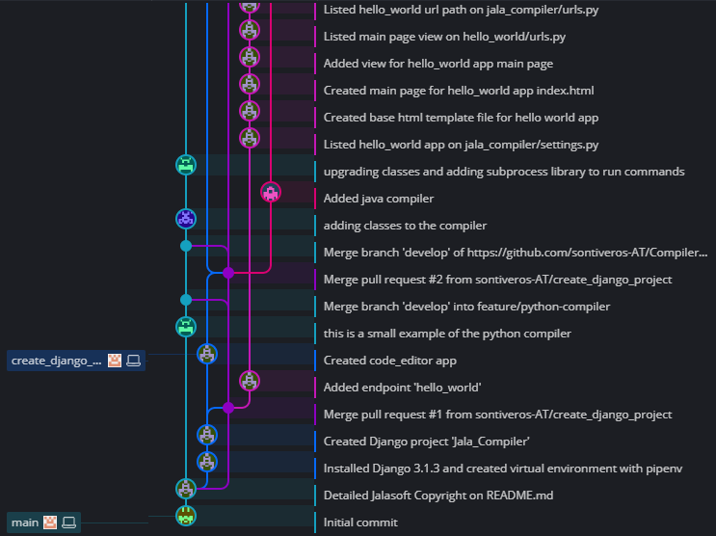
Git flow
169 commits
37 closed pull requests

Slide 8
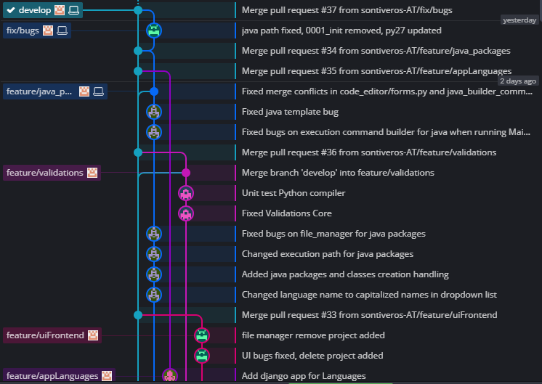
Git flow

Slide 9
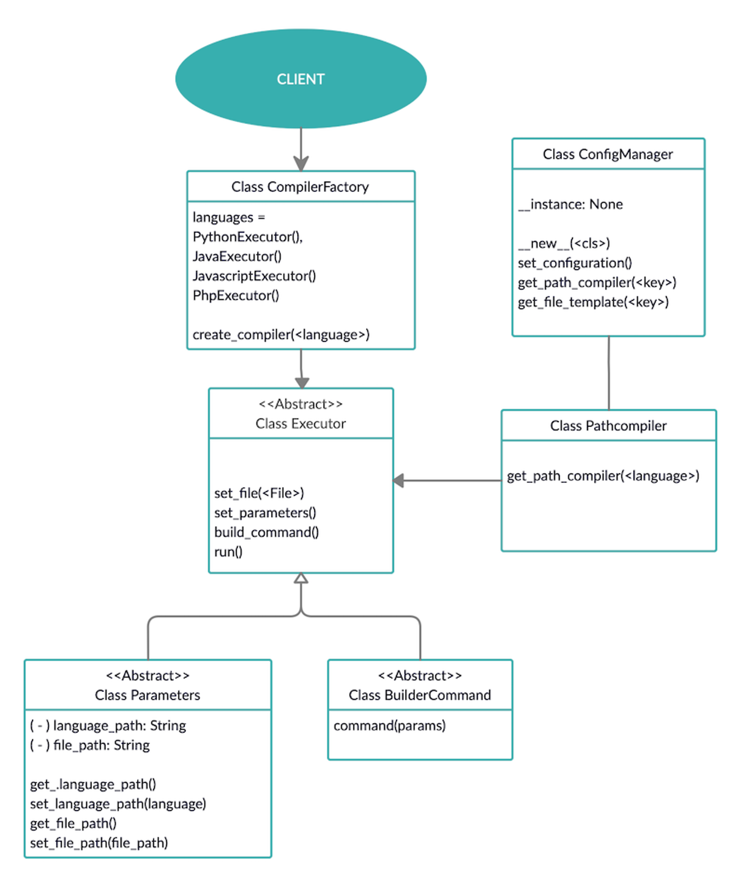
Class Diagram Relationships

Slide 10
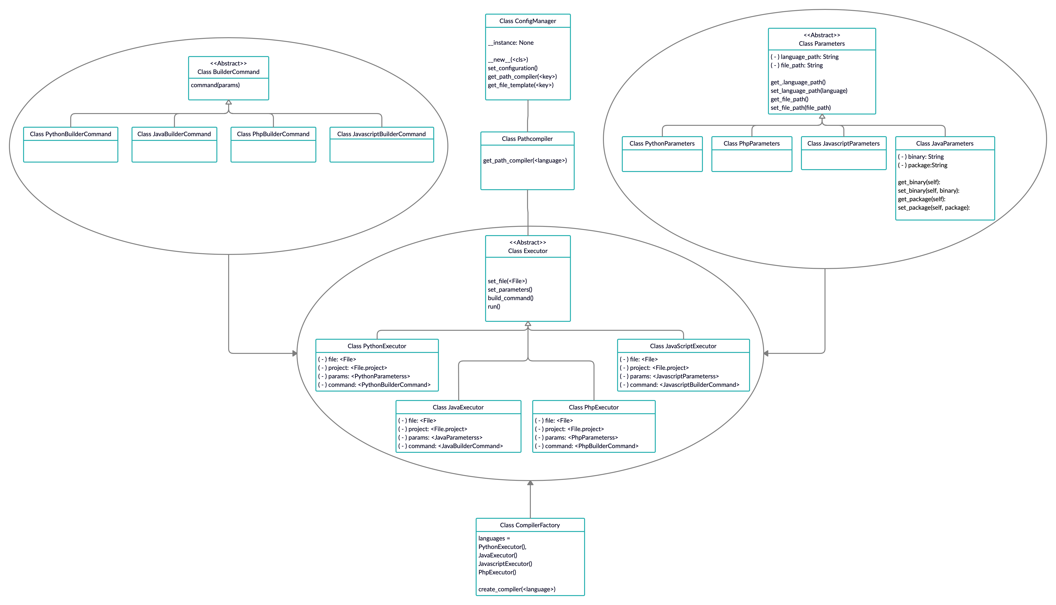
Core Class Diagram

Slide 11
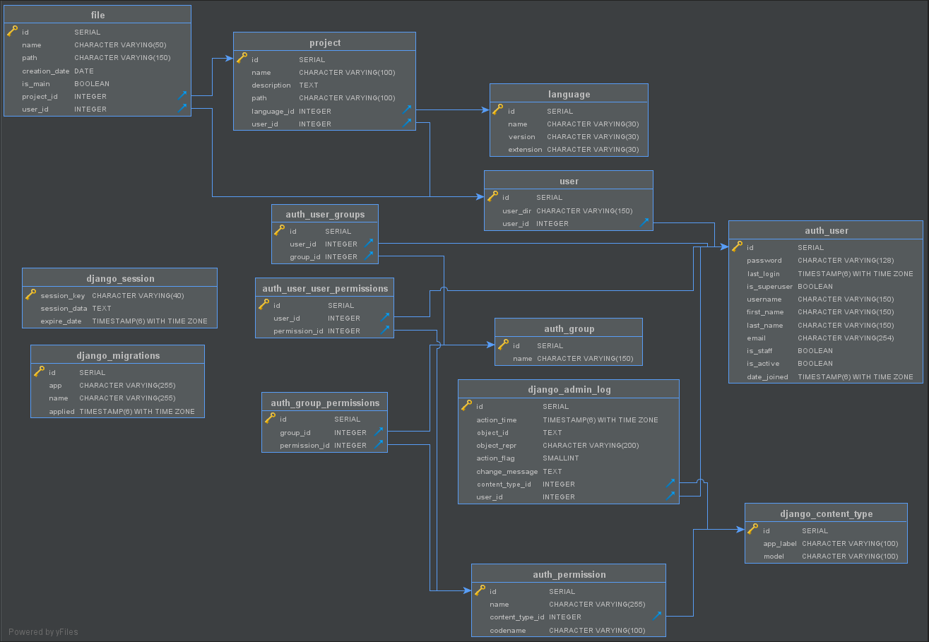
Entity-Relationship model

Slide 12
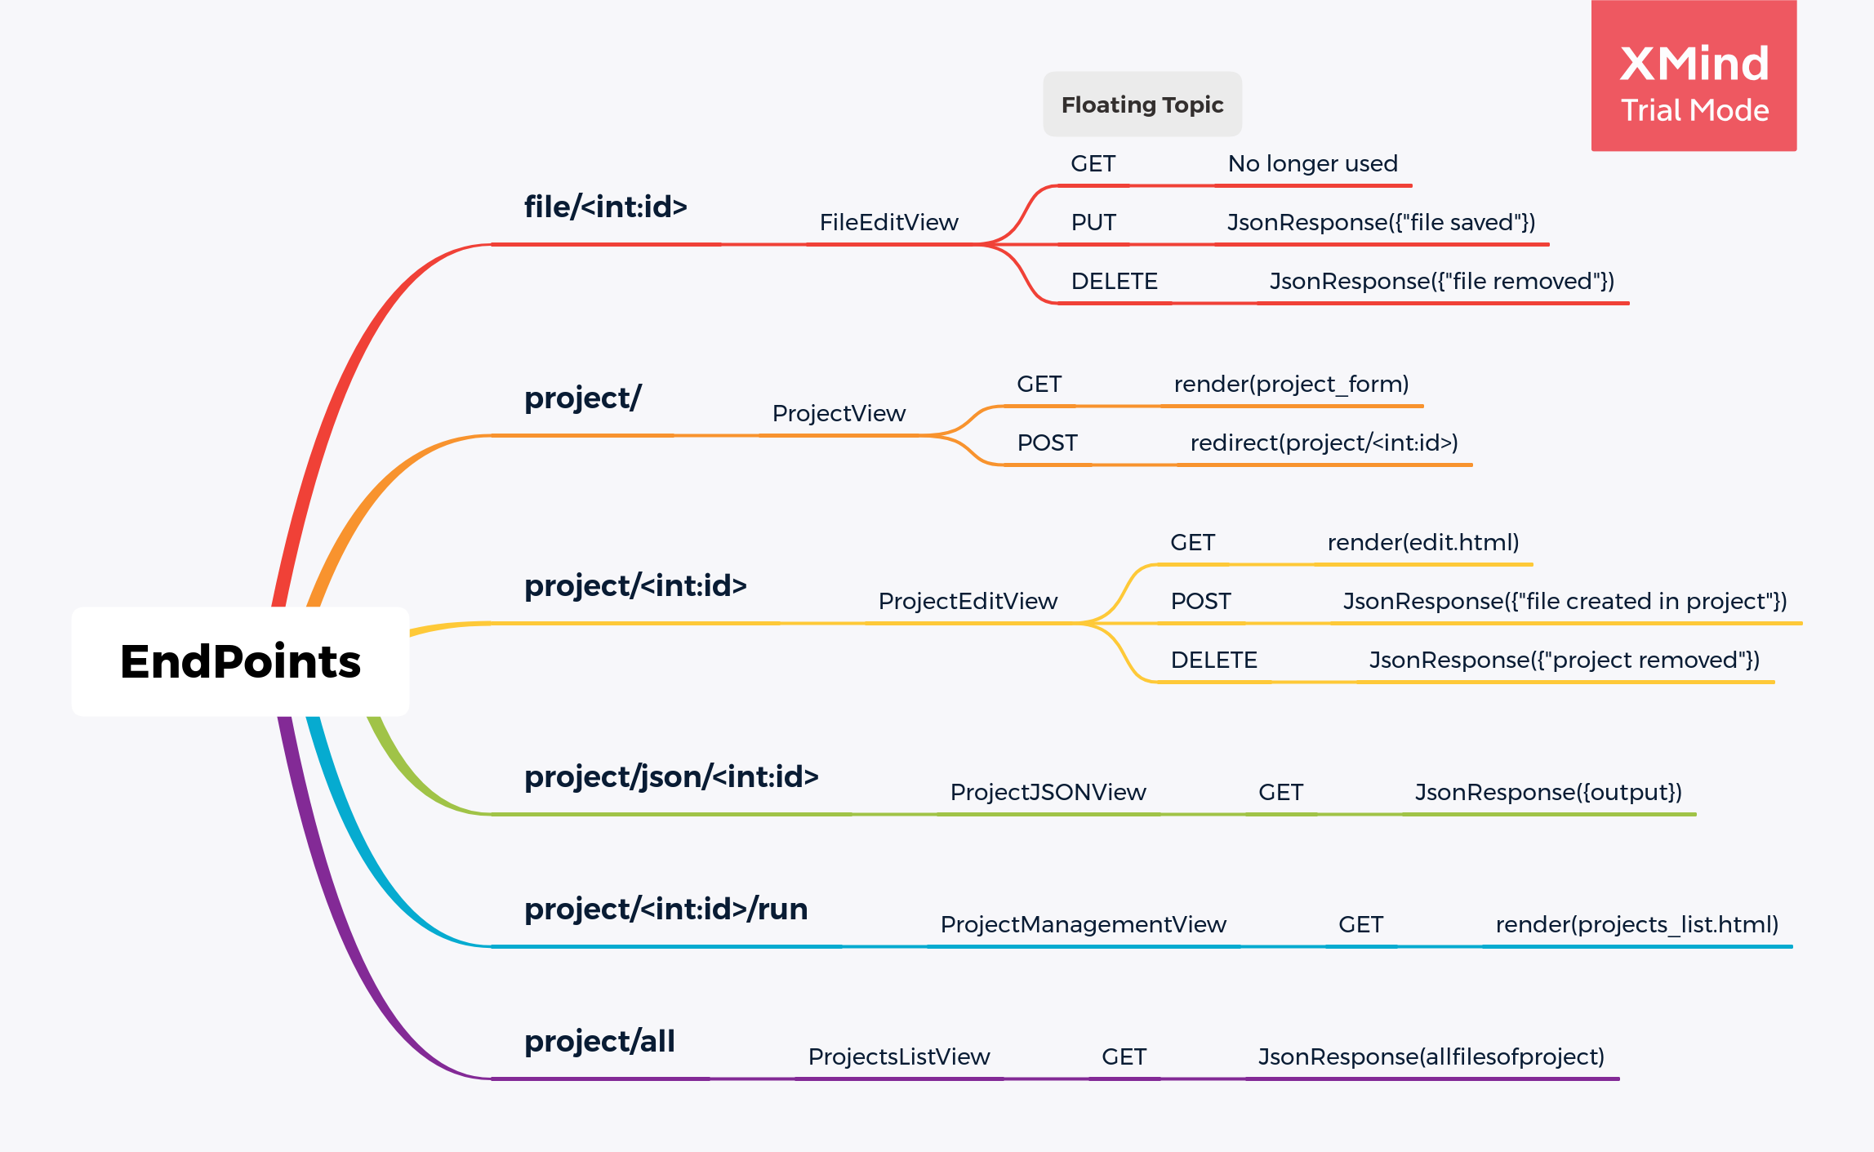

Slide 13
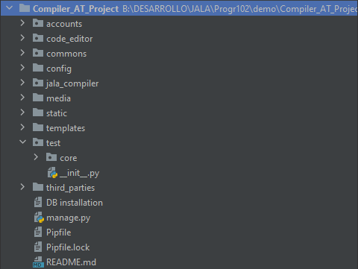
Packages structure (General)

Slide 14
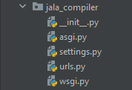
Packages structure (jala_compiler)

Slide 15
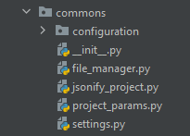
Packages structure (commons)

Slide 16
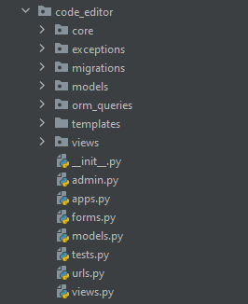
Packages structure (code_editor)

Slide 17
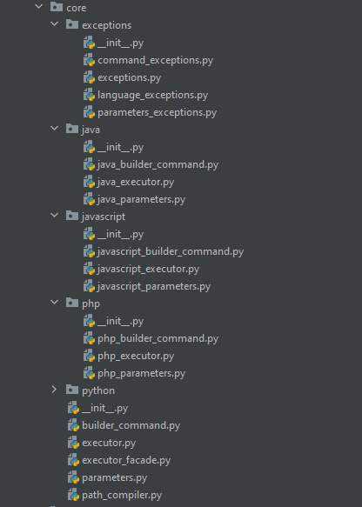
Packages structure (code_editor.core)

Slide 18
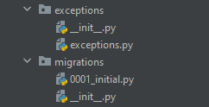
Packages structure (code_editor)

Slide 19
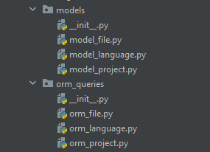
Packages structure (code_editor)

Slide 20
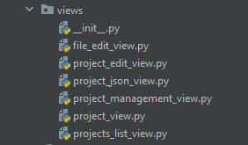
Packages structure (code_editor.views)

Slide 21
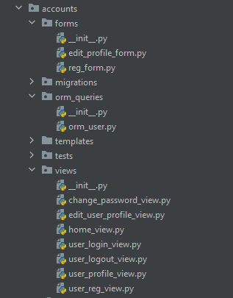
Packages structure (accounts)

Slide 22
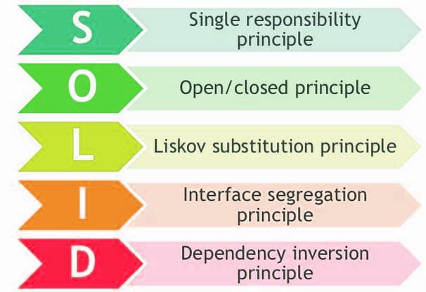
SOLID

Slide 23
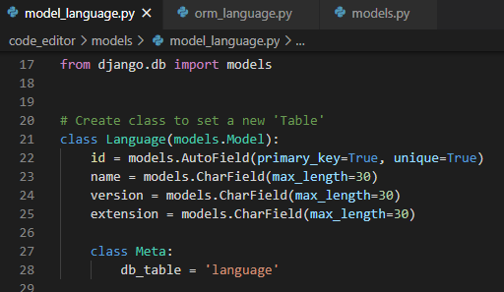
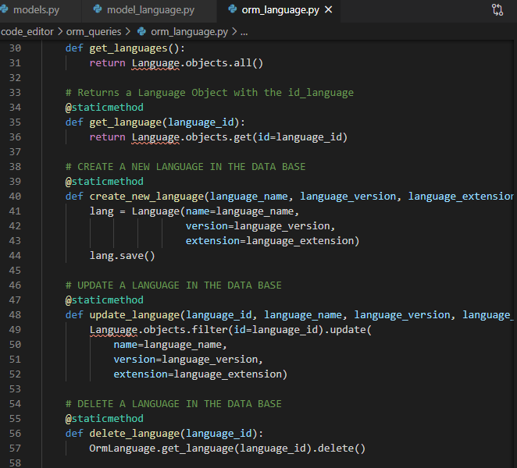
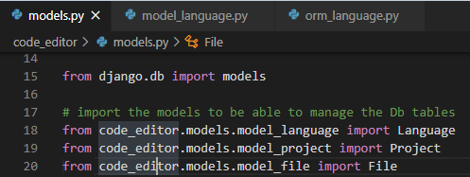
Single responsibility principle
States that a class, component, or microservice should be responsible for only one thing.

Slide 24
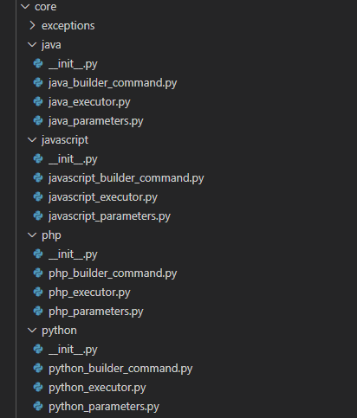
Open / closed principle
The software entities (classes, modules and functions) must be open for their extension but closed for their modification.

Slide 25
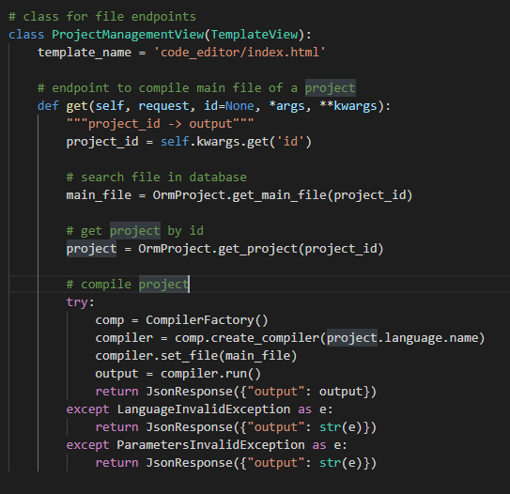
Liskov substitution principle
A subclass must be substitutable for its superclass, and if by doing this the program crashes, we are violating this principle.

Slide 26
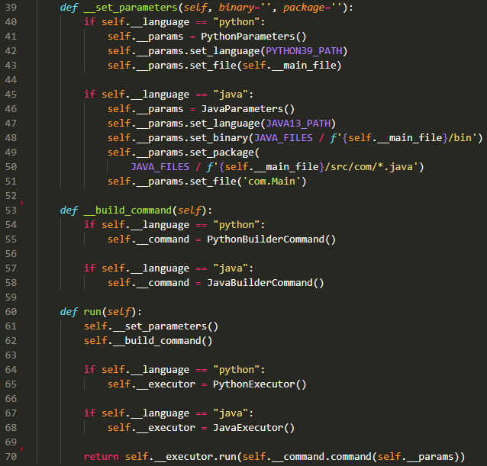
Façade pattern

Slide 27
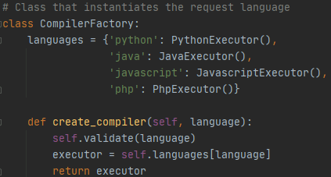
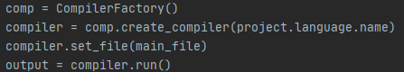
Factory Pattern

Slide 28
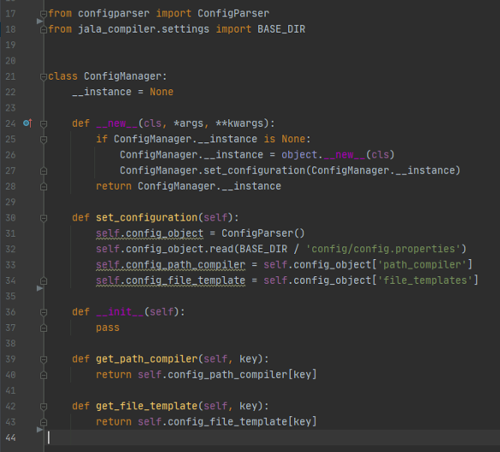
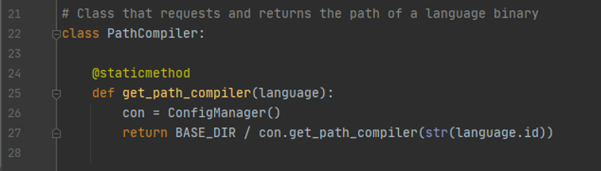
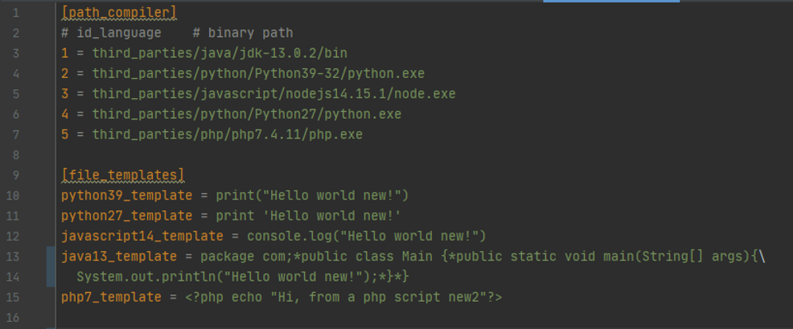
Singleton Pattern

Slide 29
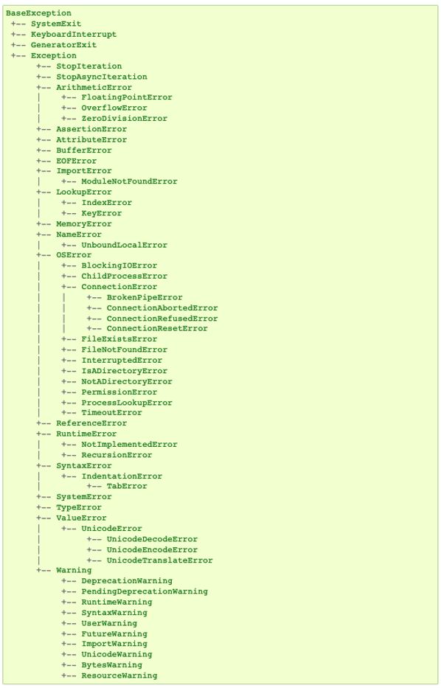
Exceptions
Custom Exceptions Classes
Handling Exceptions
Exception Propagation

Slide 30
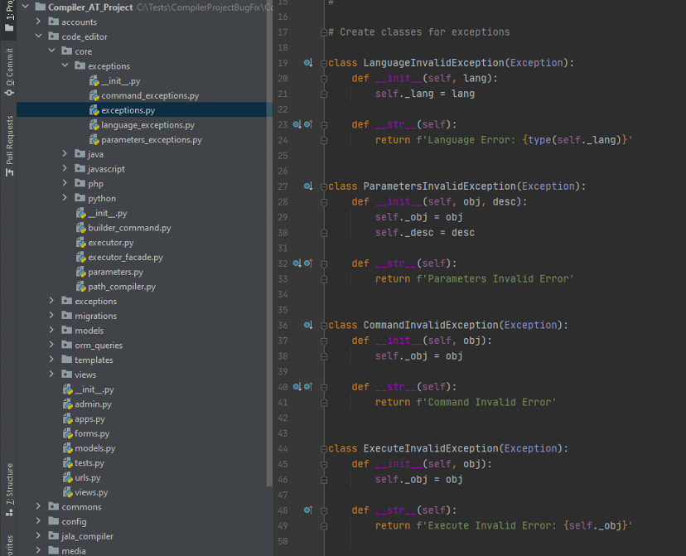
Custom Exceptions Classes

Slide 31
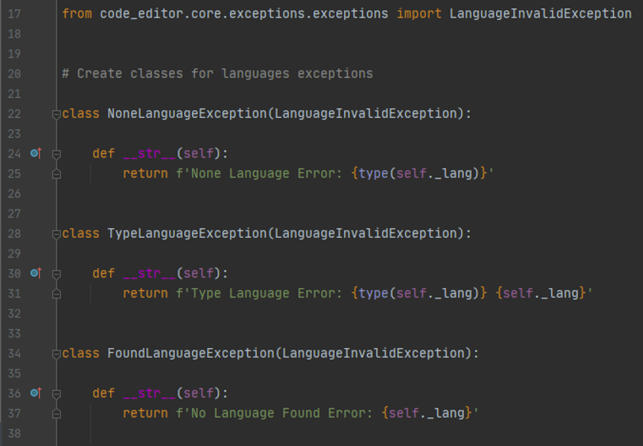
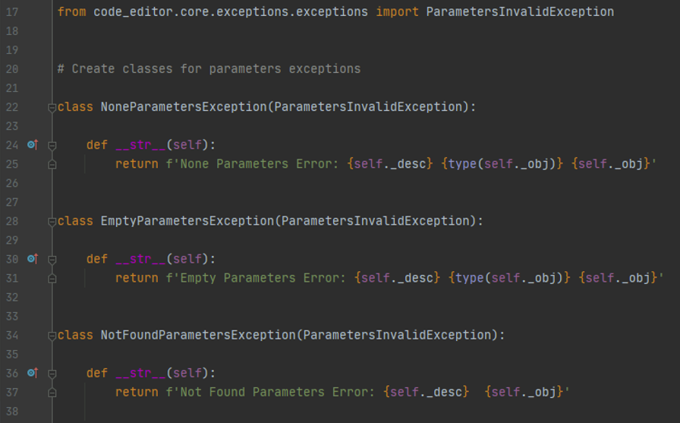
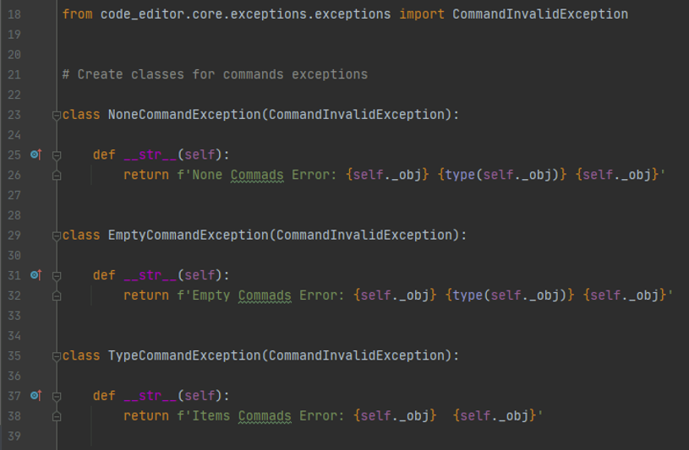
Custom Exception Classes

Slide 32
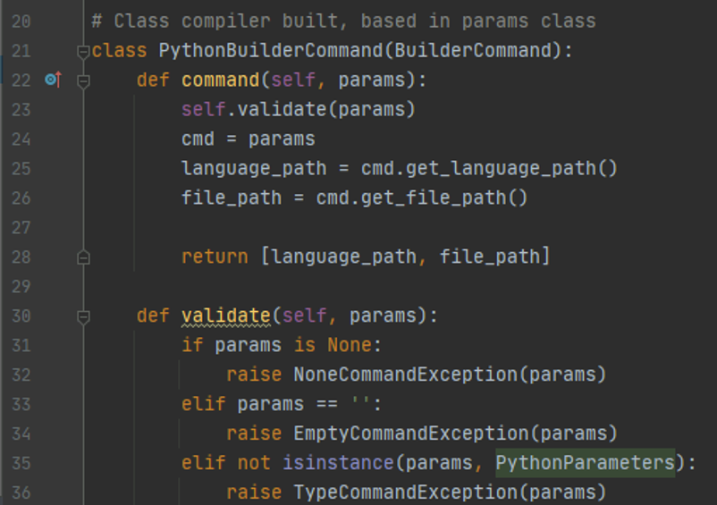
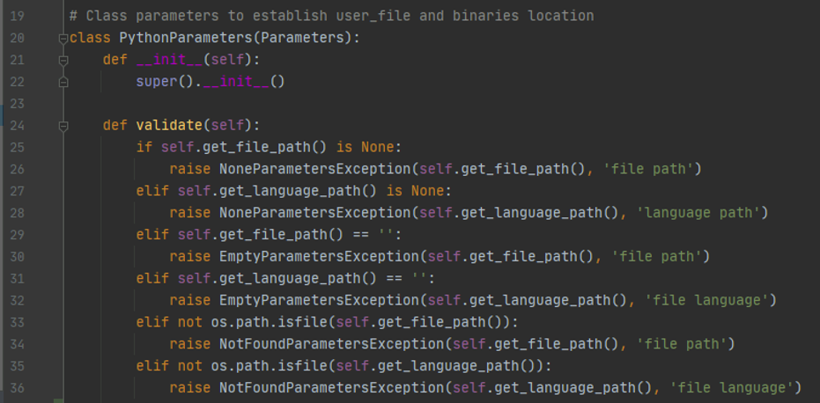
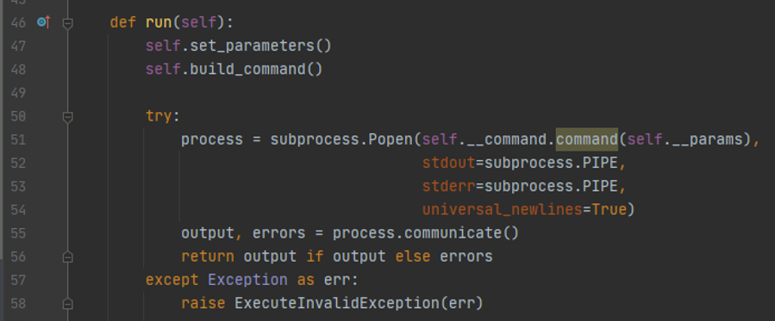
Exception Propagation

Slide 33
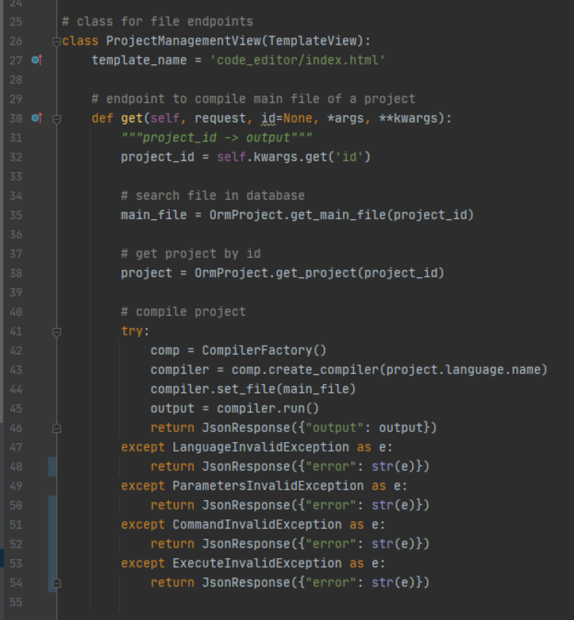
Handling Exceptions

Slide 34
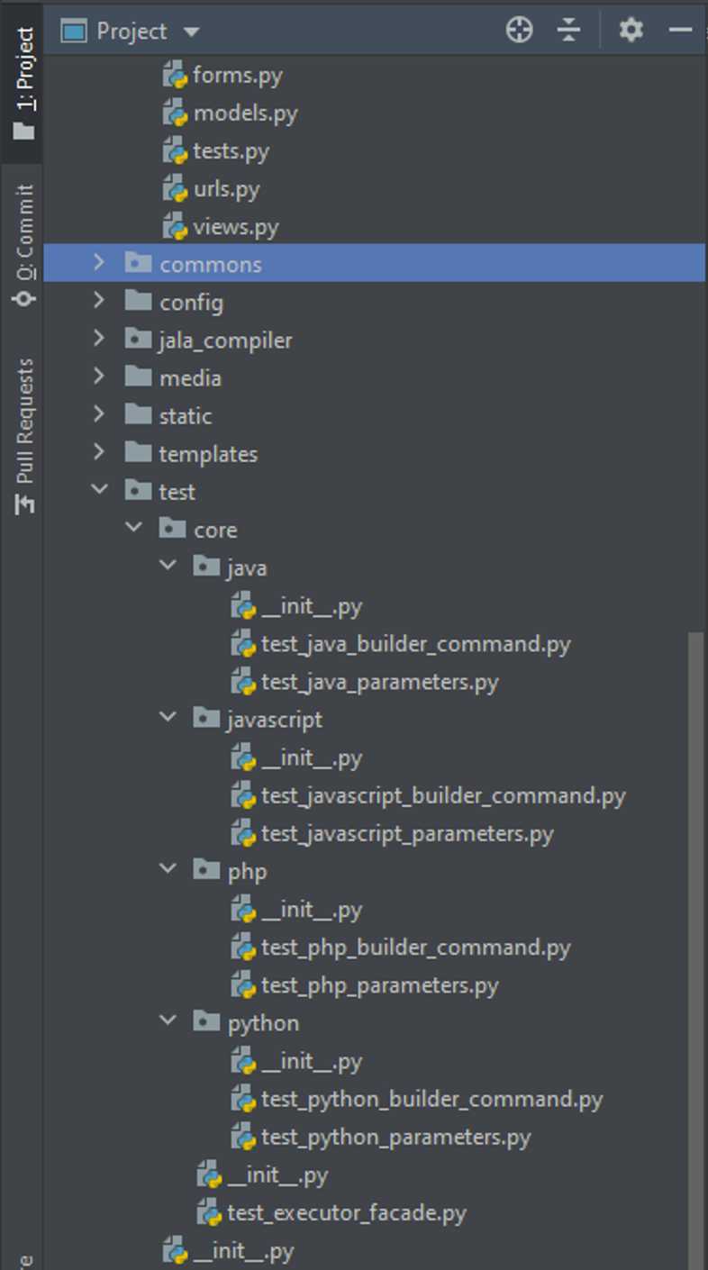
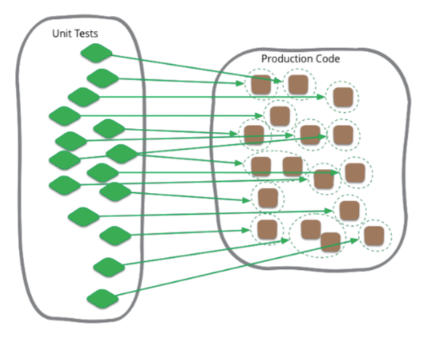
Unit Test

Slide 35
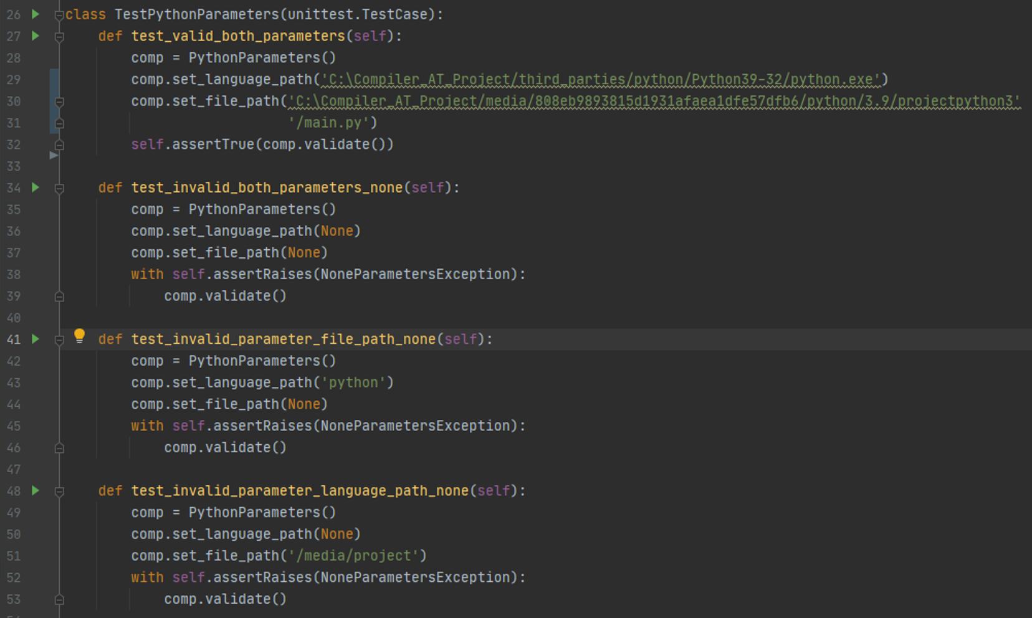
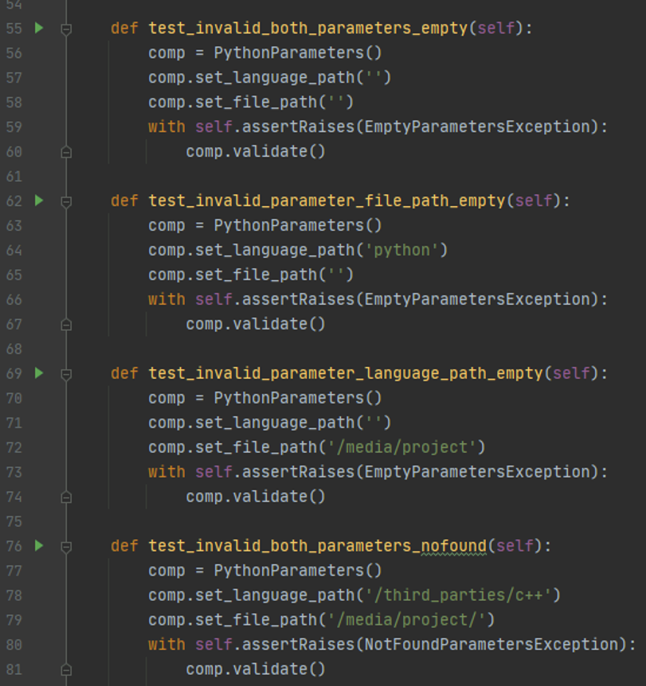
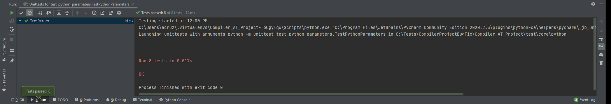
Core Unit Test

Slide 36
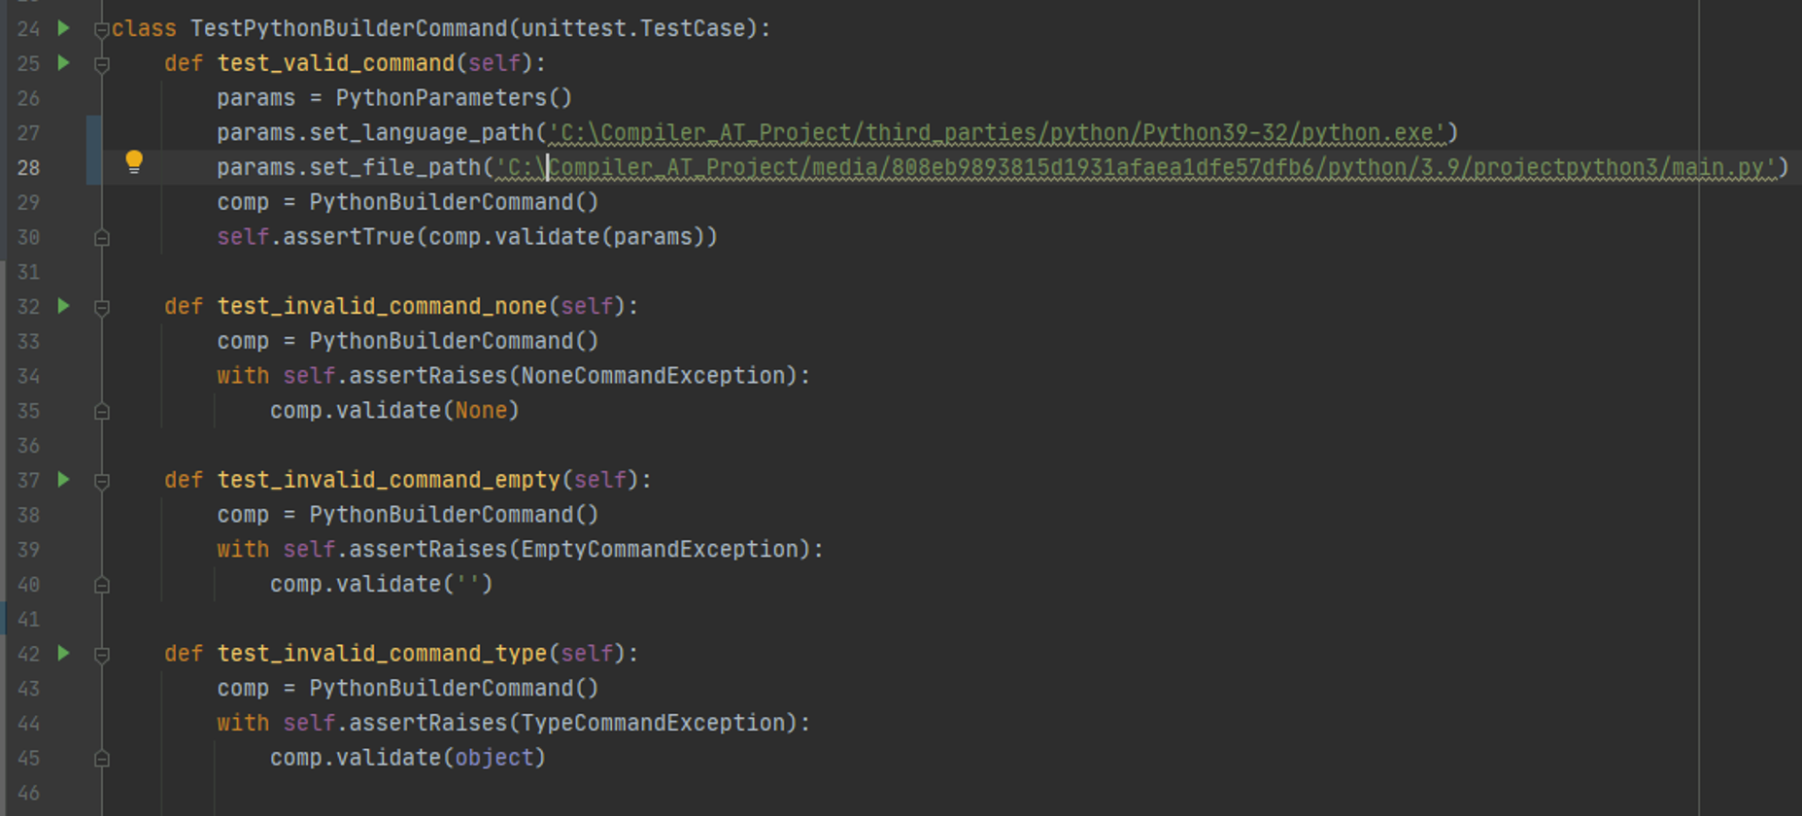
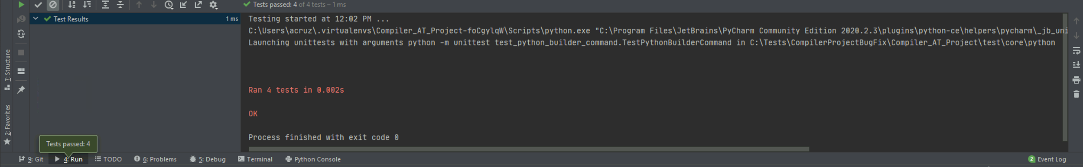
Core Unit Test

Slide 37
Known Bugs and Improvements
Know bugs
Django Orm could not support all DDBB integrations
Process id Integration for async requests
Load languages to database when db is created (the first time)
Same name file in directory, wrong selected
Improvements
Create Packages for each language
Rename directories
Run each file
all endpoints return json
New UI with framework
PUT request for Django
Unittest for Orm and ClassViews
Ideas to Implement
File update reader
Live teamwork
Project Time limit
Download project
Sync local with cloud storage
offline edit save
Debug, linter, github, Integration

